Slide 1
WELCOME
To our presentation

Slide 2
DIGITAL PORTFOLIO
STUDENT NAME : R.JAYA SRI
REGISTER NO : 20924U30011
DEPARTMENT : BSC.SCS
COLLEGE : SHANMUGA INDUSTRIES ART’S & SCIENCE
COLLEGE
UNIVERSITY : THIRUVALLUVAR

Slide 3







Digital
portfolio

Slide 4
AGENDA
PROBLEM STATEMENT
PROJECT OVERVIEW
END USERS
TOOLS AND TECHNOLOGIES
PORTFOLIO DESIGN AND LAYOUT
FEATURES AND FUNCTIONALITY
RESULTS AND SCREENSHOT
CONCLUSION
GITHUB LINK

Slide 5
PROBLEM STATEMENT
“Professionals struggle to effectively showcase their unique skill
and diverse work in a digital market place, often lacking then to technical expertise to create compelling online portfolios that the stand out. This makes it difficult to attract new clients or employer
And hinders their ability to demonstrates their full professional of
Capabilities.

Slide 6
PROJECT OVERVIEW
The Digital Portfolio Project is designed to showcase an individual’s skills, achievements, and personal growth through a rated collection of digital artifacts. This project provides a platform to demonstrate creativity, technical expertise , and reflective thinking while presenting academic , professional , or personal accomplishments in an organized and visually engaging format . The portfolio may include written work , projects , presentations , certificates , multi
media content , and other evidence of learning or experience. Beyond serving as a repository of past work , the digital portfolio highlights progress over time and communicates one’s strengths to educators, employers, or peers.

Slide 7
END USER
*An end user is a person or other entity that consumes or makes use of the goods or services produced by businesses.
*In this way, an end user may differ from a customer since the entity or person that buys a product or service may not be the one who actually uses it.
*Delivery to the end user is often the final step in manufacturing and selling products.
*End user experience and support are crucial for the success of user-oriented products and services.
*References to end users as customers are most common in the technology industry.
*Delivery to the end user is the last step after a company creates, develops, tests, and markets a product.
*One goal of the business is to empower the end user to accomplish something that wasn't possible for them before using its well-conceived quality product.

Slide 8
Tools & Technologies
HTML:
The html structure defines the various sections of your websites ,including
navigation , profile , about , experience , projects , blogs , contact , and
footer.
Navigation includes both desktop and hamburger menu options.
Sections like “profile” , “about”, “experience” , “project” , “blogs”, and
“contact” have their respective content.
The footer contains navigations links and copy right information.

Slide 9
CSS:
The CSS code provides styling for different sections and elements.
It defines general styles , transitions , and hover effects for link and
buttons.
Specific styles are applied to the desktop and the hamburger
navigation menu.
Section like profile , about , experience , projects, blogs , contact,
and footer have distinct styling to create a visually appearing the
layout.

Slide 10
JAVA:
The JavaScript code defines a toggle Menu function that toggles
the opening and closing of the hamburger menu.
The menu and icon elements are selected using document. Query
Selector , and their classes are toggled between “open” and not
“open”.
TOGGLEMENU FUNCTION:
PURPOSE:
To handle the opening and closing of the hamburger menu.
It toggles the visibility of the menu and changes that the
hamburger icon’s appearance.

Slide 11
PORTFOLIO DESIGN & LAYOUT
LANDING/COVER:
Your name & tagline(e.g., “Creative Designer| Front-End
Developer.
A clean hero imagine or minimalist background.
Quick navigation (Home| About| Project| Contact).
CONTENT:
A short introduction (who are you, what you do, your goals).
Professional photo or avatar
Icon grid (Adobe, Figma , HTML, python, etc,.

Slide 12
FEATURES & FUNCTIONALITIES
FEATURES:
Brief bio or tagline
Professional photo or logo.
Clear navigation.
FUNTIONALITIES:
Search & Filters (for projects or blogs)
Interactive Media(video, animations, prototypes)
Dark/Light Mode Toggle
Responsive Design (works on mobile, tablet, desktop)
Downloadable Portfolio Pack ( resume + selected works)

Slide 13
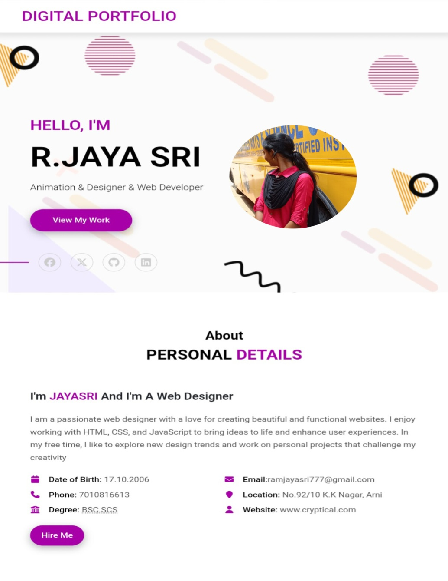
RESULTS & SCREENSHOT

Slide 14
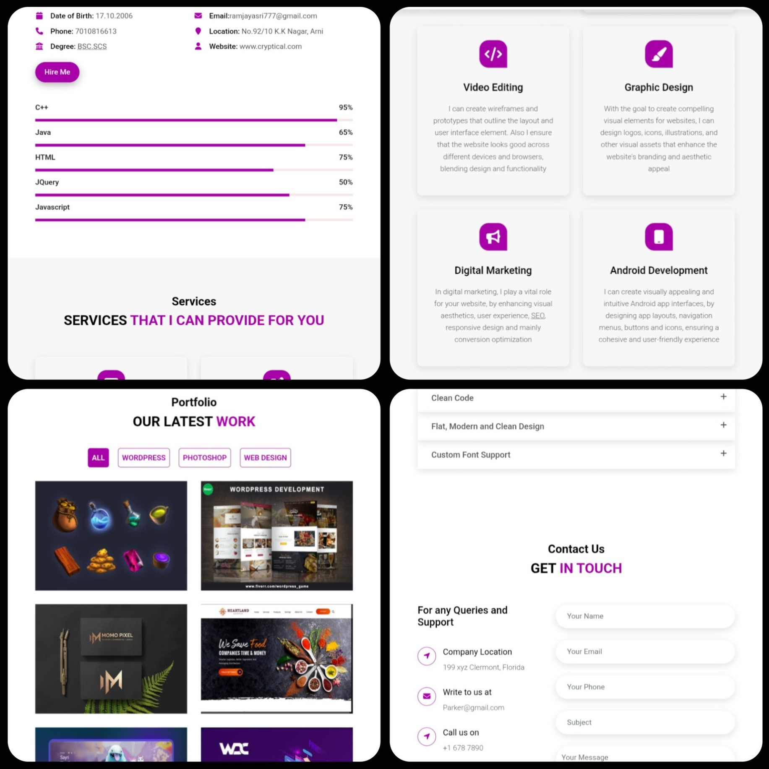

Slide 15
CONCLUSION
A digital portfolio serves as a power full tool
to showcase skills, achievements, and creativity in an organized and visually
Appealing way. It not only highlights personal and professional growth but all
So provides easy access for employers, educators, or clients to evaluate one’s
Capabilities. By combining design, content, and functionality, a well-structured
Portfolio reflects individually , professionalism , and readiness for future the
Opportunities. Ultimately , it acts as a bridge between learning and career
Advancement, making it an essential asset in today’s digital world.

